Slide 1
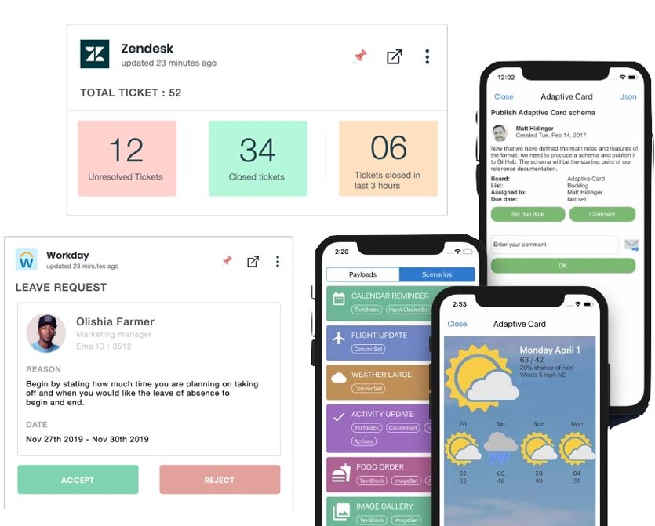
Adaptive Cards Renderer for React-Native
How BigThinkCode team-built RN Adaptive card to support for every mobile platform
Notes:
Introduction about BigThinkCode, What we do, our specialization etc Probably include a slide at the end?

Slide 2
Agenda
Quick recap about Adaptive card
React Native Adaptive card deep dive
Our Motivation
Implementation details
How to integrate RN adaptive card with your app?
How can you extend RN adaptive card component in RN way?
Showcase of few app uses RN adaptive card SDK
Microsoft Viva Connections app
E-commerce –MS Luis based chatbot to reduce customer care queries and chat-based shopping experience
Road-Map
Where to start to Contribute for the RN Adaptive card OSS?
Q&A

Slide 3
Motivation
Notes:
Talk about how we got introduced to adaptive cards
What was available in 2018

Slide 4
React Native Renderer for Android
React Native Renderer for iOS
Native Realm
Android Wrapper Native Module
iOS Wrapper Native module
React Native Bridge
JS Realm
Adaptive Cards JS module Wrapper
Notes:
How we supported the client request

Slide 5
Gaps
Rendering and Interaction need to pass multiple levels
Requires Native programming experience
Multiple components to maintain
Notes:
Why we decided to build react-native renderer

Slide 6
Implementation
Notes:
Why we decided to build react-native renderer

Slide 7
Truly React native renderer
No native programming dependency
Highly configurable and extensible
Easy to integrate and maintain in host applications

Slide 8
Building blocks
MODEL FACTORY
CONFIGURATION MANAGER
Payload
Common Components
Theme Configuration
Rich Text Components
Host Configuration
Component
Custom Components
Style Configuration

Slide 9
Installation

Slide 10
Add package npm install adaptivecards-reactnative
Import the root component import AdaptiveCard from 'adaptivecards-reactnative'
Render the component with required props <AdaptiveCard payload={} updateKey={} hostConfig={} themeConfig={} onExecuteAction={} onParseError={} containerStyle={} contentContainerStyle={} cardScrollEnabled={false} contentHeight={500} />
Notes:
Talk about visualizer and how It is helpful

Slide 11
KEY FEATURES
Extensible Developers can override the existing card elements or implement custom elements using custom types by registering custom render methods in the model registry.
Data Binding Data binding is supported since v2.2
React-Native Windows Implementation includes support for projects running react-native-windows. Alternate approaches are included to overcome windows specific context API issues.
Accessibility All the components are fully accessible. It supports both touch-based and keyboard-based accessibility features.
Mark-Down Engine Inbuilt expression engine identifies the markdown languages in the text elements and transform them to the expected format. All the TextBlock and RichTextBlock elements in the JSON payload are processed by the markdown rule engine using the predefined regex configurations.

Slide 12
Extensibility
React native renderer allows to override/ignore built-in components and add custom components
To override built-in TextBlock element,
Registry.getManager().registerComponent('TextBlock',CustomTextBlock);
To add support for new element Rating, add the component in the registry as below :
Registry.getManager().registerComponent('Rating', RatingComponent);
To remove the support of an element type (To ignore the rendering of specific element type),
Registry.getManager().removeComponent('Input.Date');

Slide 13
Demo of RN adaptive card renderer

Slide 14
Adaptations
Notes:
Talk about Microsoft viva
Hand over to Zaid for viva demo

Slide 15

Microsoft Viva connections + Adaptive Cards

Slide 16


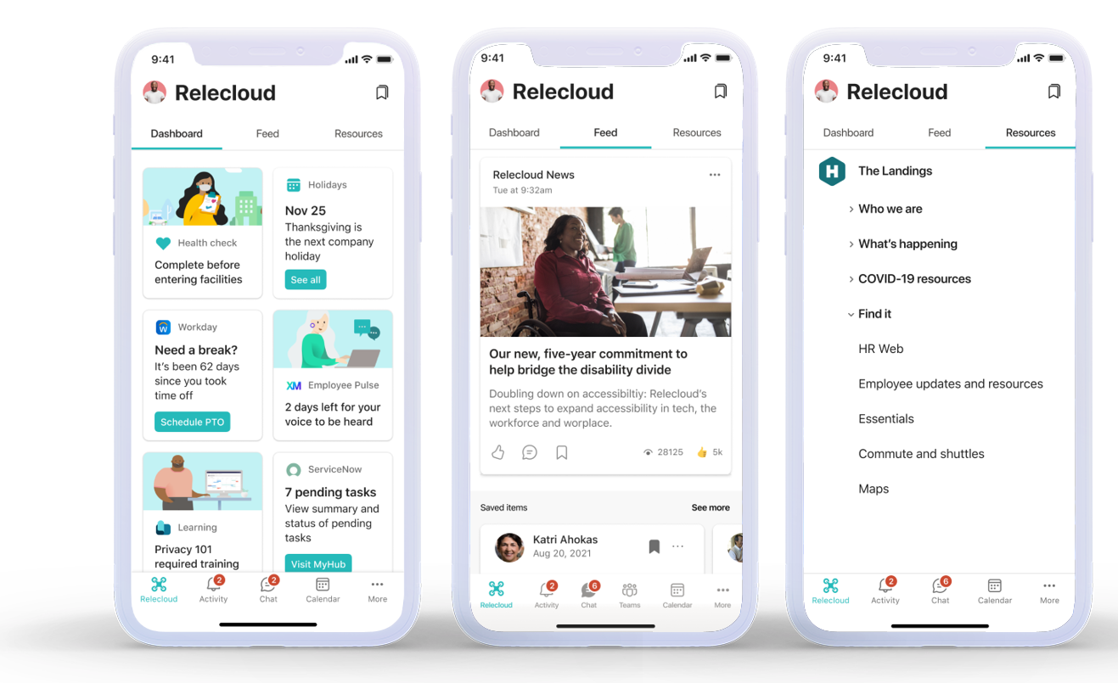
Viva/Connections Introduction
Microsoft Viva is an employee experience platform that brings together communications, knowledge, learning, resources, and insights in the flow of work.
Viva Connections is the gateway to company culture and communications.

Slide 17
Viva Connections Mobile + Adaptive Cards
Viva Connections Dashboard experiences are powered by Adaptive Cards.
Dashboard on Mobile app integrates with React Native Adaptive Card SDK.
Strong partnership of more than 18 months
Collaboration on more than 100 features and bug fixes in the SDK
Enabled critical Dashboard scenarios like theming and styling
Platform/Libraries upgrades like React Native, DateTimePicker, Picker etc
Schema alignment for Containers, Column-Sets etc
A11y enhancements and support

Slide 18
Demo
https://www.microsoft.com/en-us/videoplayer/embed/RE4Ukqm?autoplay=true

Slide 19
Resources
Viva Connections Employee Communication Solution | Microsoft Viva
aka.ms/Viva/Connections/Platform
Adaptive Card Extension Design Gallery (Microsoft AppSource)

Slide 20
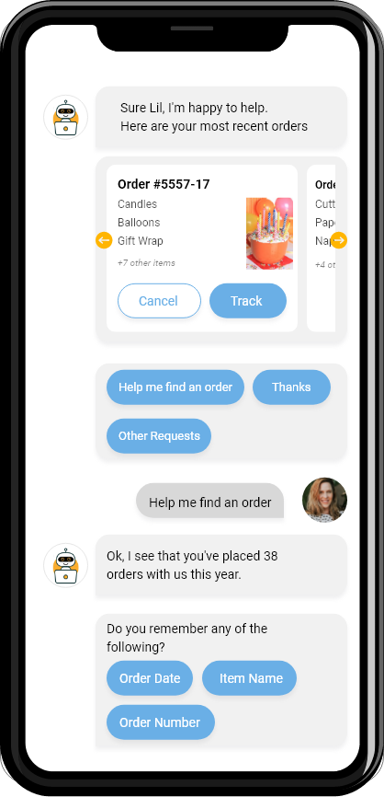
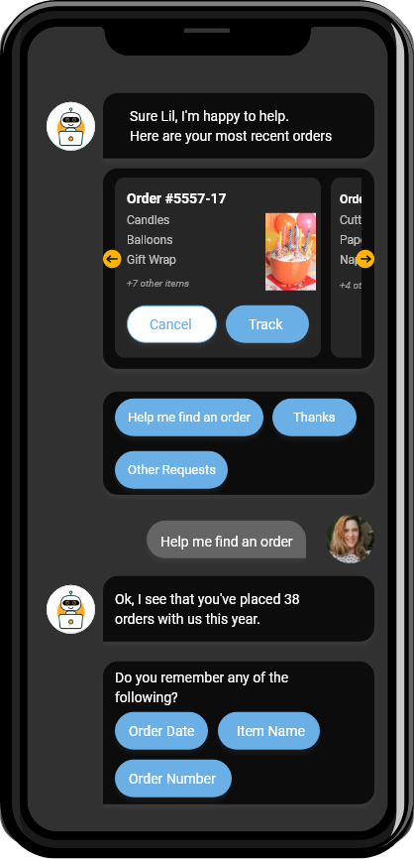
LUIS – based chatbot for E-Commerce customer service
Notes:
Add images

Slide 21
To Contribute,
Submit bugs and help us verify fixes as they are checked in.
Review the source code changes.
Contribute bug fixes.
This project has adopted the Microsoft Open-Source Code of Conduct. For more information see the Code of Conduct FAQ
Notes:
Talk about Pic2Card
Recommondation engine and future ideas

Slide 22





Top Contributors
Balaji Rajendran BalajiR
Vivek Kozhisseri
vivekvijayakrishnan
Ibrahim Sulaiman
ibrahimsulai
Vasanthakumar S vasanth-s
Pragadeesh Kanagavel pragadeeshk

Slide 23
Thank you
Do check our other contribution Pic2Card
GitHub: https://github.com/BigThinkcode/AdaptiveCards/tree/fork-main/source/pic2card
To know more: https://adaptivecards.io/blog/2020/Community-Call-November/

